Slide 1
Online Movie Ticket Booking App
Group 7

Slide 2
Team Members
1
6
Shwetha M
2529884
Sonam Roy
2529661
2
Sathiyaseelan X
2527395
7
Srivatssan M
2528201
3
Srimathi Elango
2526609
8
Saravanan Shanmugam
2526837
4
Sathiyanantham N
2527952
9
Shaiq Reddy Inthiyaz
2526997
5
Senthamizhselvi
2527322

Slide 3
Introduction
There is traditional way for booking ticket, Just going to Theatre where the respective film we need to watch. And book tickets in- hand by waiting in queue. Where we have no idea of how far the screen will be.
This project gives real life understanding of online movie ticket booking system and it overcomes the above mentioned drawbacks. Here we provide automation for movie ticket booking system through internet. Here, we used various technologies which bring efficiency.

Slide 4
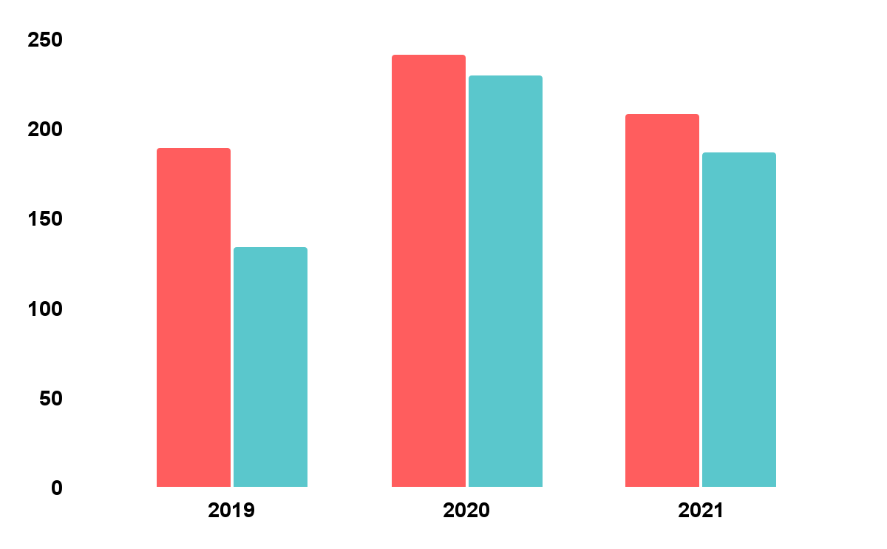
Background Of The Project
NMS Cinemas is a chain of single screen theatres that screen movie shows of different genres and languages at very genuine prices. It was established in 2004 in Pune, India. Recently, the business analysts noticed a decline in sales since 2010. They found out that the online booking of movie tickets from apps, such as BookMyShow and Paytm were gaining more profit by eliminating middlemen from the equation.
As a result, the team decided to hire a Full Stack developer to develop an online movie ticket booking web application with a rich and user-friendly interface. You are hired as the Full Stack Java developer and are asked to develop the web application. The management team has provided you with the requirements and their business model so that you can easily arrange different components of the application

Slide 5
Tools And Technologies
Back End
Spring Boot
Front End
Angular
Server
Tomcat
Testing
Selenium
Postman
Data Base
My SQL

Slide 6
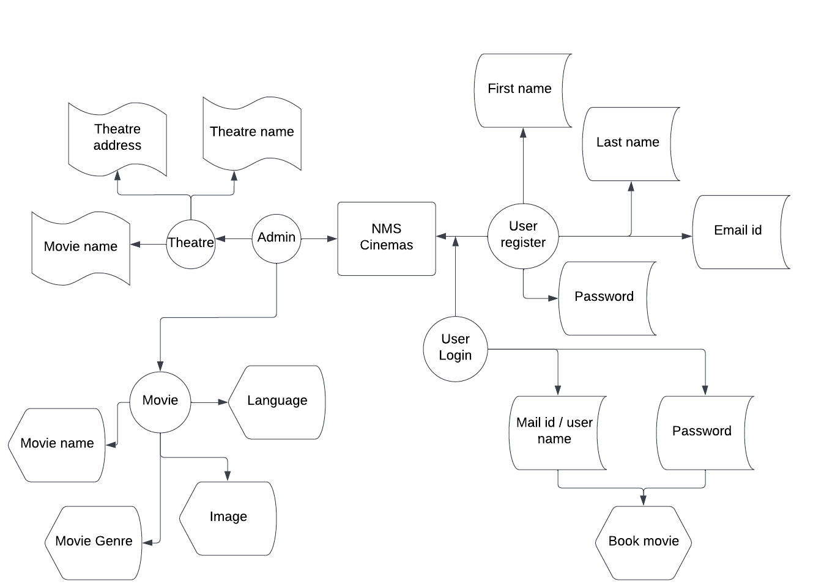
ER Diagram

Slide 7
ADMIN
MODULE

Slide 8
Admin Role
1
2
3
4
Admin Login
Add Movie
Add Theater
Admin Register

Slide 9
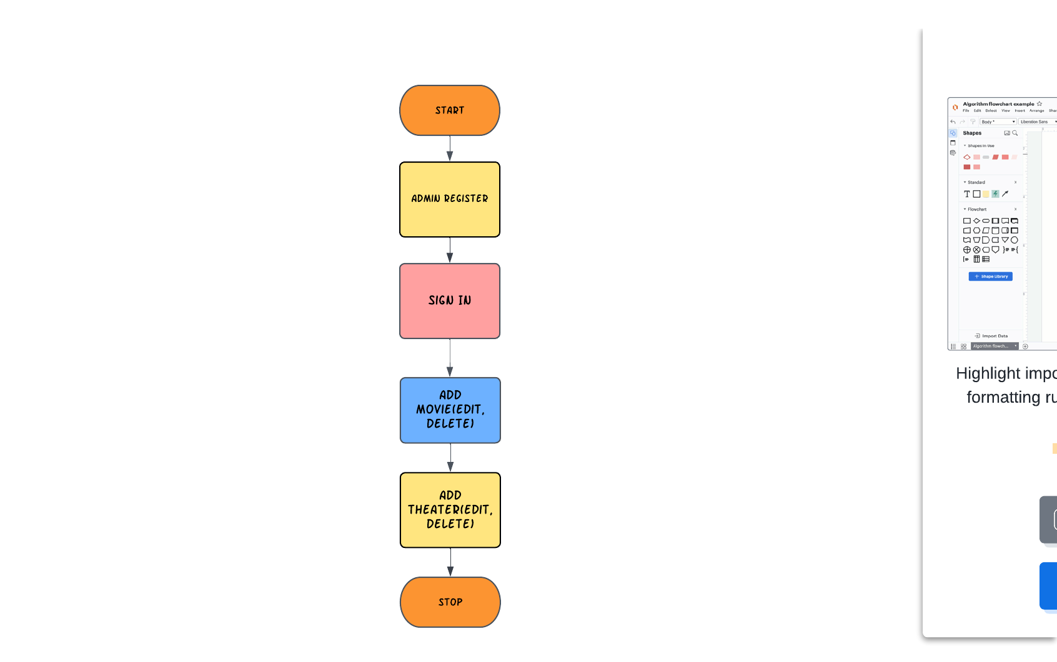
Admin Flow Chart

Slide 10
Admin Register and Login
Admin register -> Database
After registering -> Admin can Login in Login page.
Submit -> Admin dashboard.

Slide 11
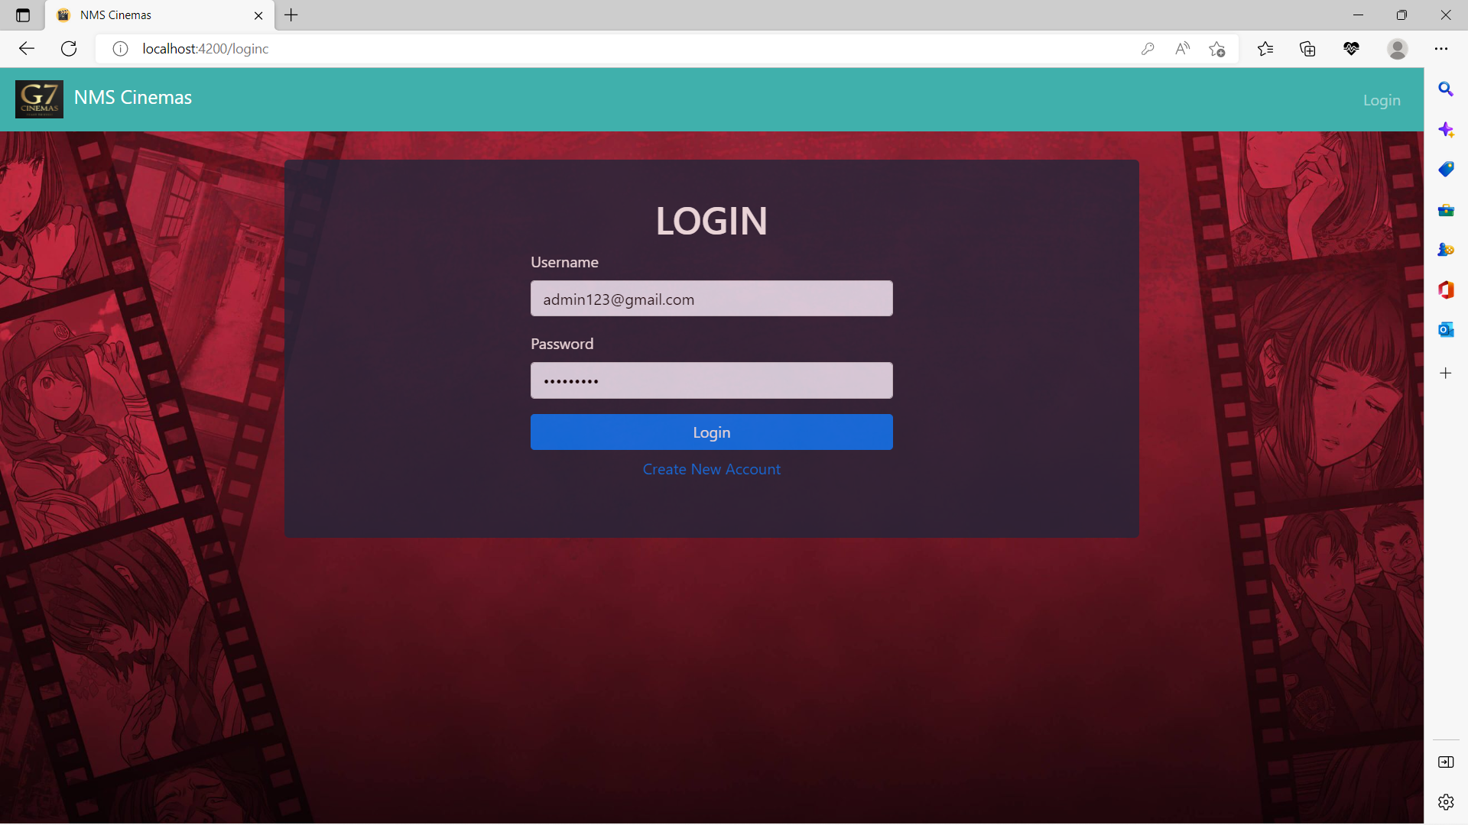
Admin Register and Login

Slide 12
Admin Dashboard
Admin Dashboard is a header section of the website.
Dashboard dropdown -> Movies and Theatre.
Add movies.
Add theatre.
Logout button -> Login page.

Slide 13
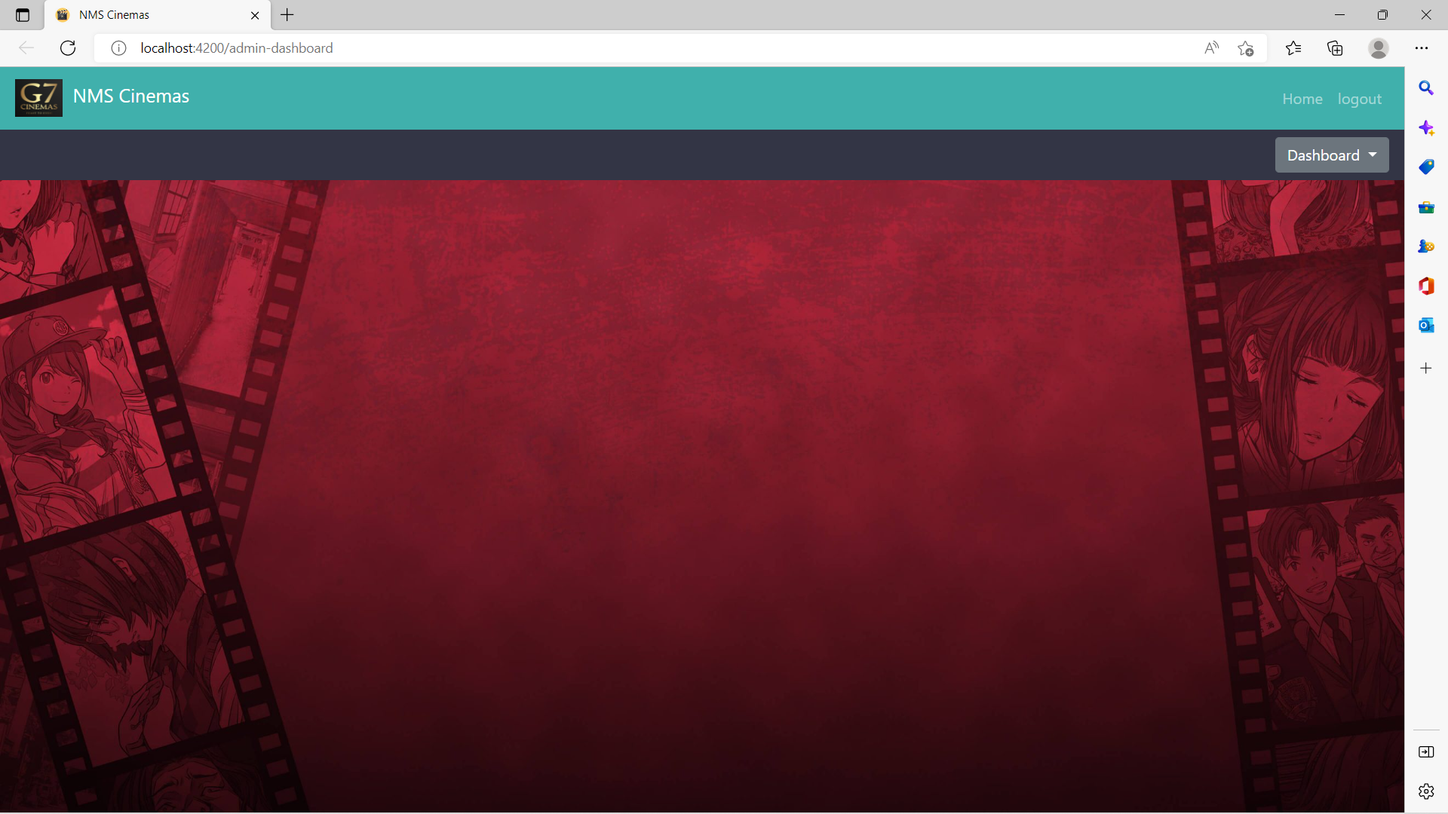
Admin Dashboard

Slide 14
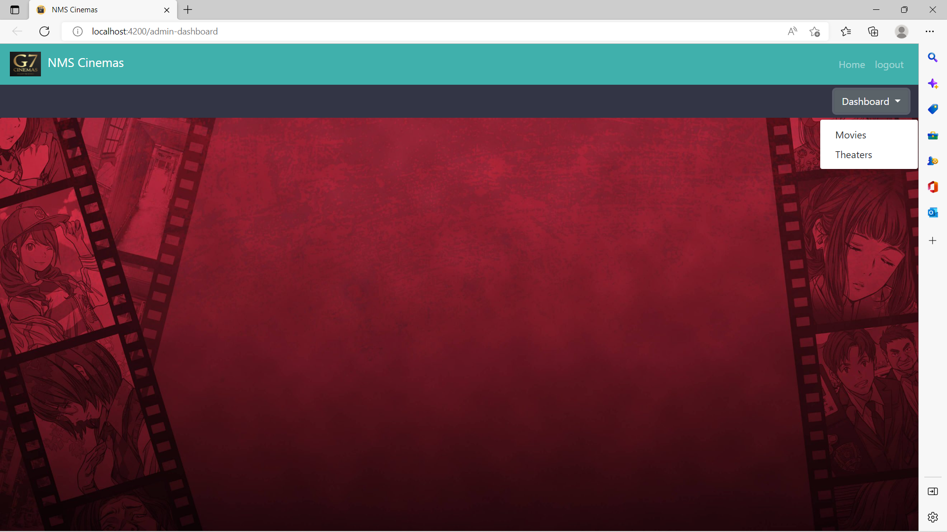
Admin Dashboard

Slide 15
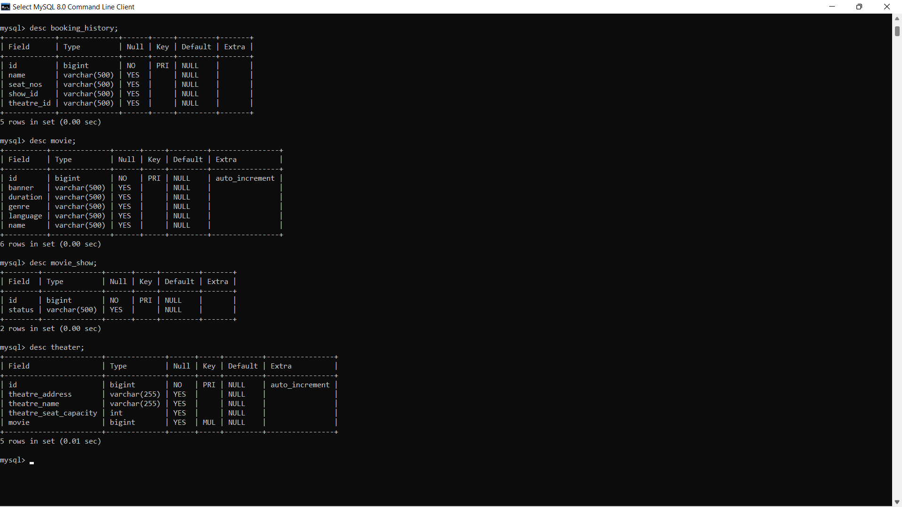
Schema
Database

Slide 16
Schema
Database

Slide 17
Add Movie
To add movies -- dashboard ->Movie -> Add Movie
User select movies added by admin
Added movies -> stored in database.
Adding movies includes,
Genre
Language
Duration
Image.

Slide 18
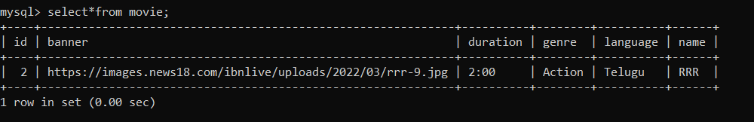
Add Movie

Slide 19
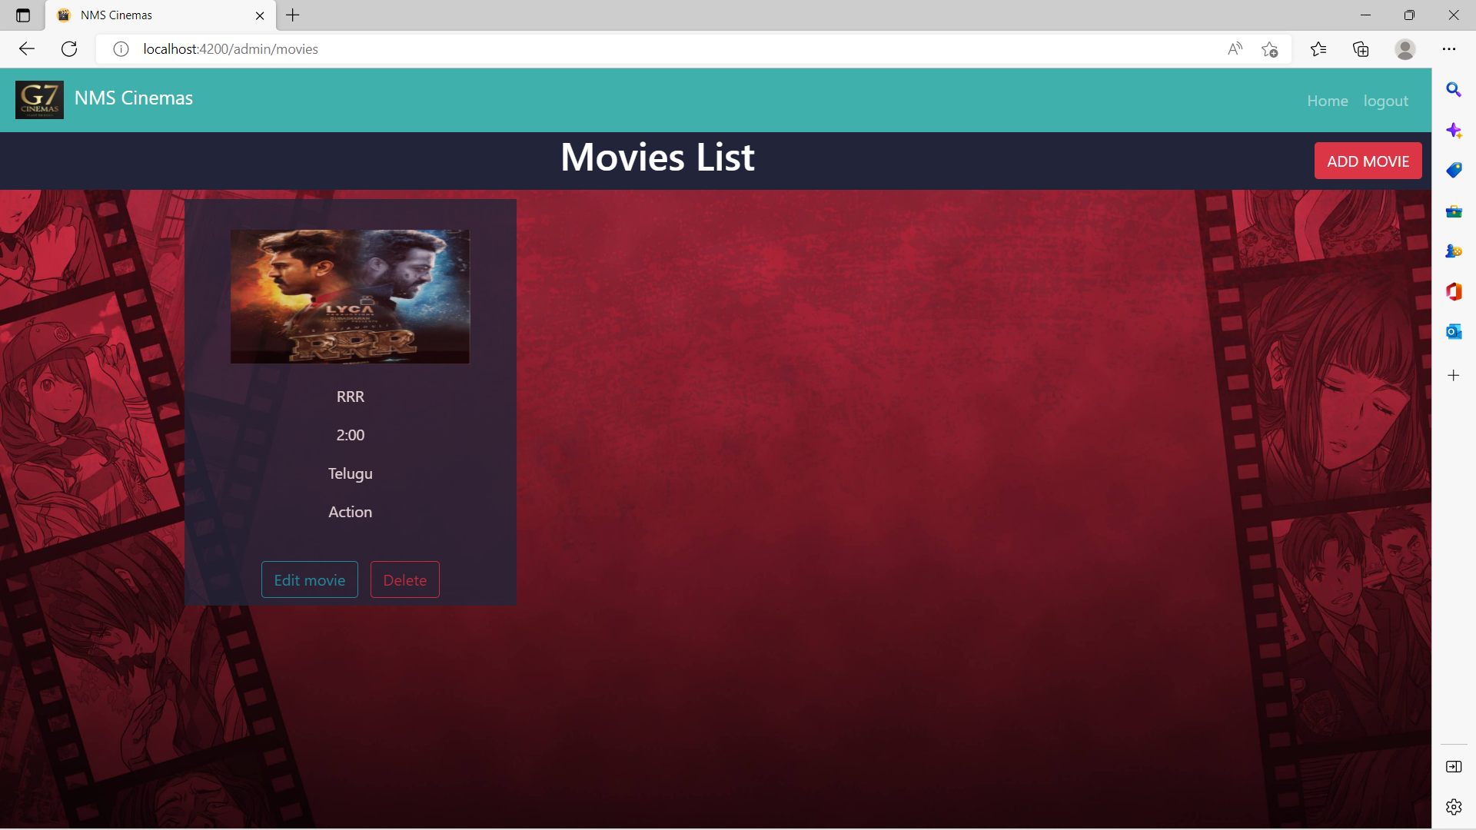
Add Movie

Slide 20
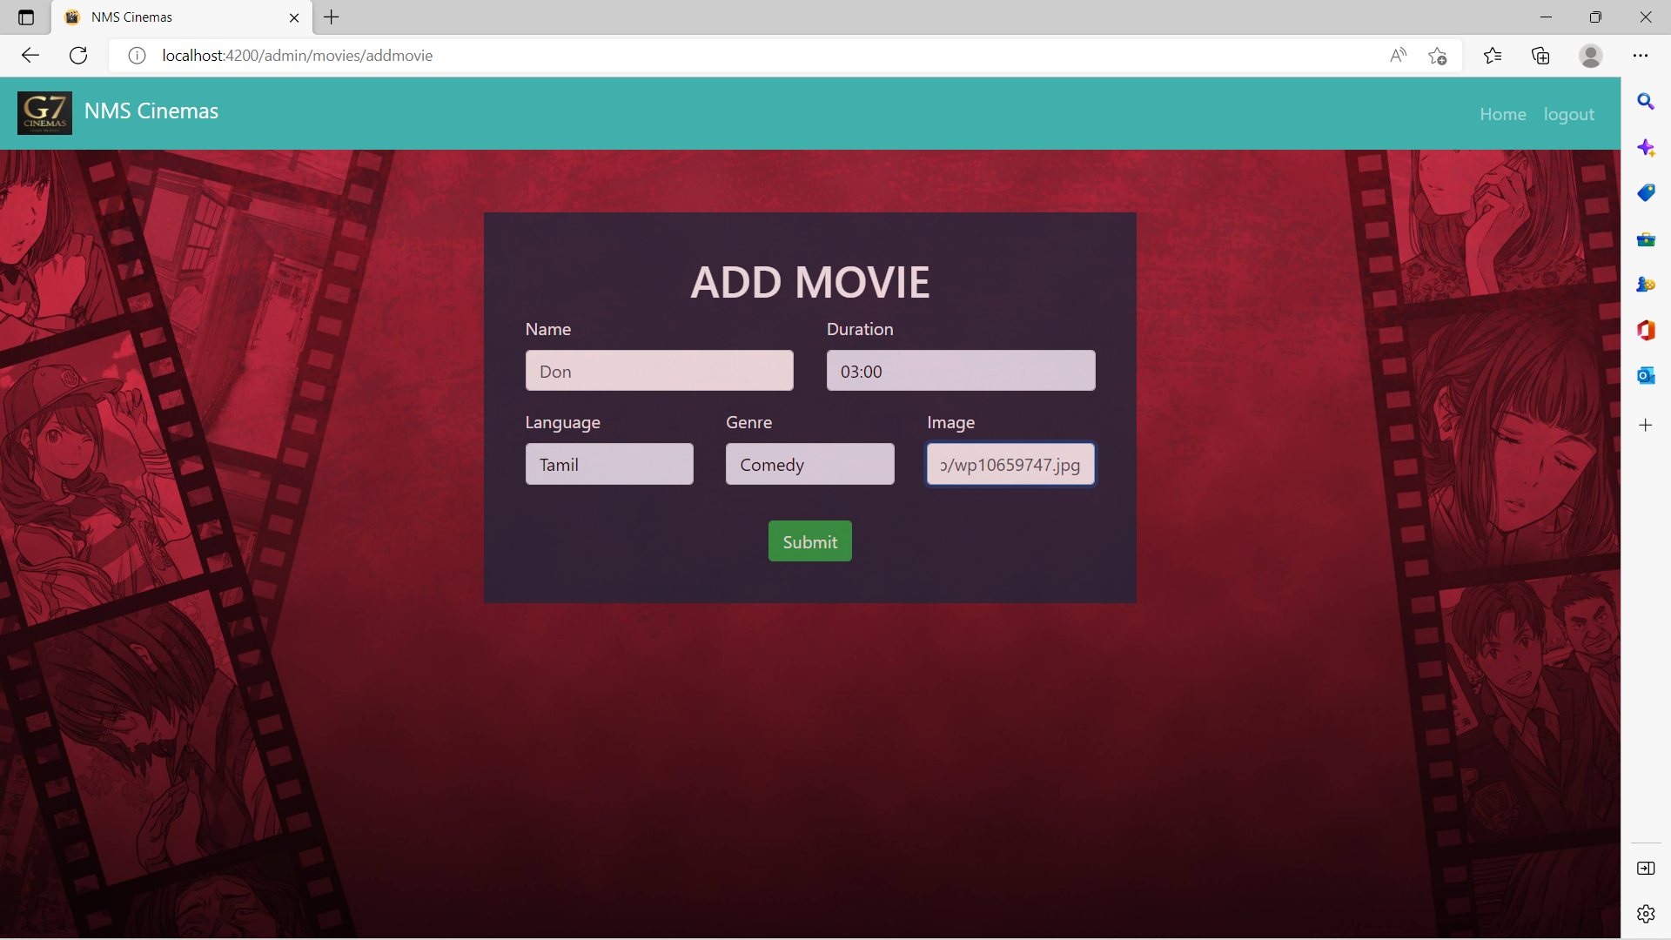
Add Movie

Slide 21
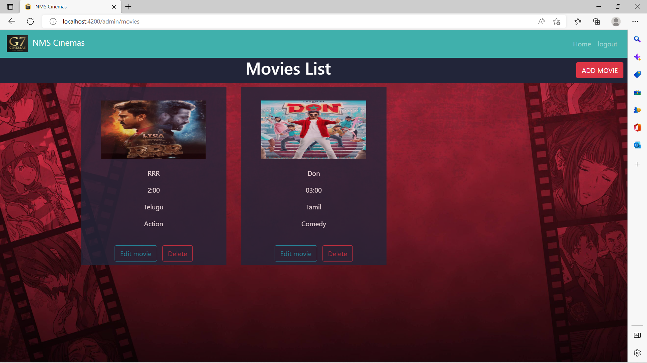
Add Movie

Slide 22
Add Theatre
To add theatre , dashboard ->Theatre -> Add Theatre.
Added Theatres ->stored in database.
User -> select wished Theatre.
Adding theatres includes,
Theatre name
Address
Movie

Slide 23
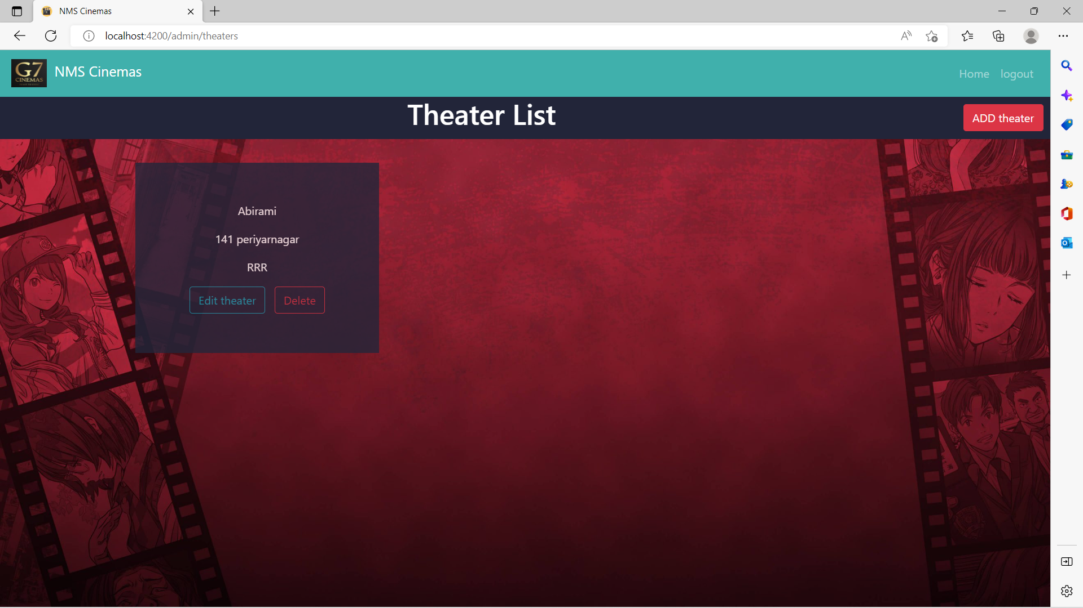
Add Theatre

Slide 24
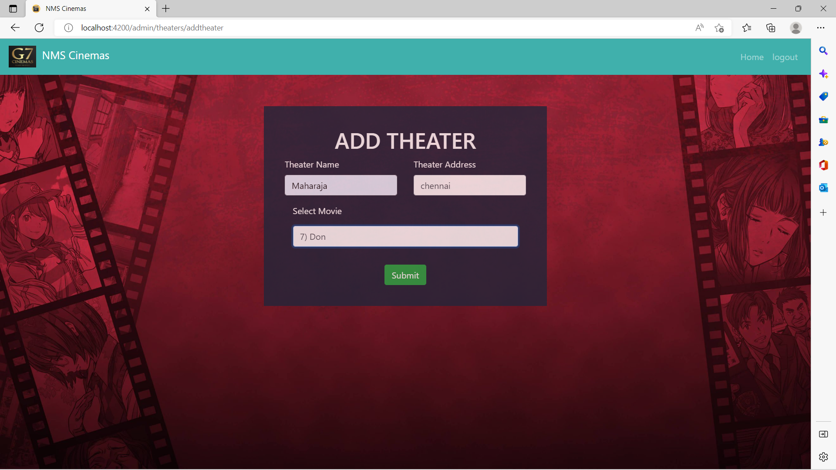
Add Theatre

Slide 25
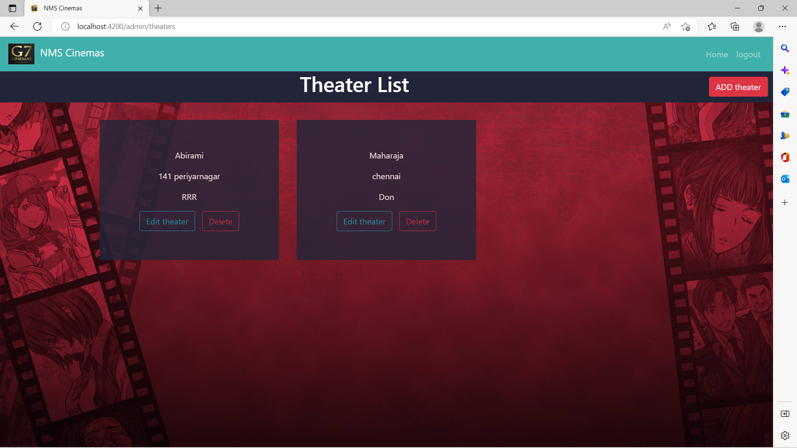
Add Theatre

Slide 26
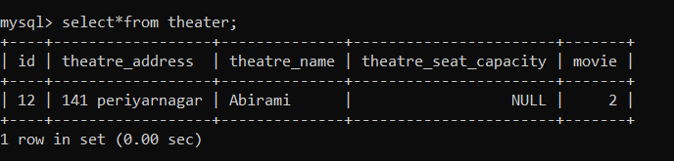
Add Theatre

Slide 27
USER
MODULE

Slide 28
User Role
Login
Register
Select Movie
Select Theatre
Seamless Payment
Booking Summary

Slide 29
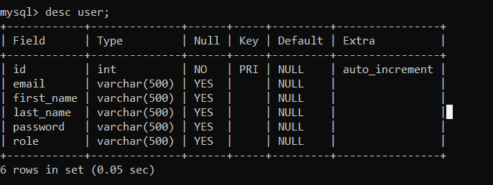
Schema
Database

Slide 30
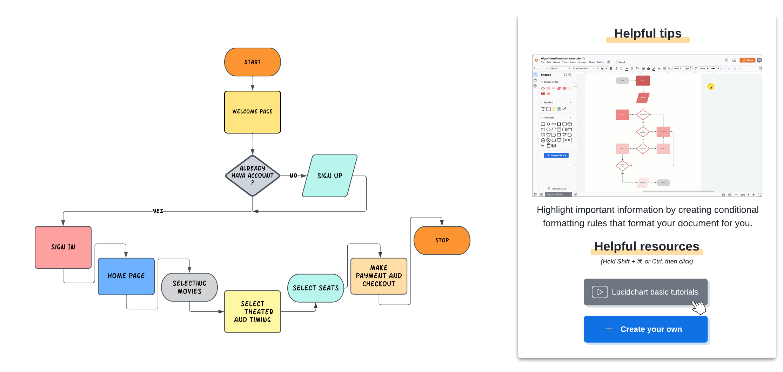
User Flow Chart

Slide 31
User Register and Login
Create new acc -> new user register
Store in database
Already registered -> login-> User dashboard.

Slide 32
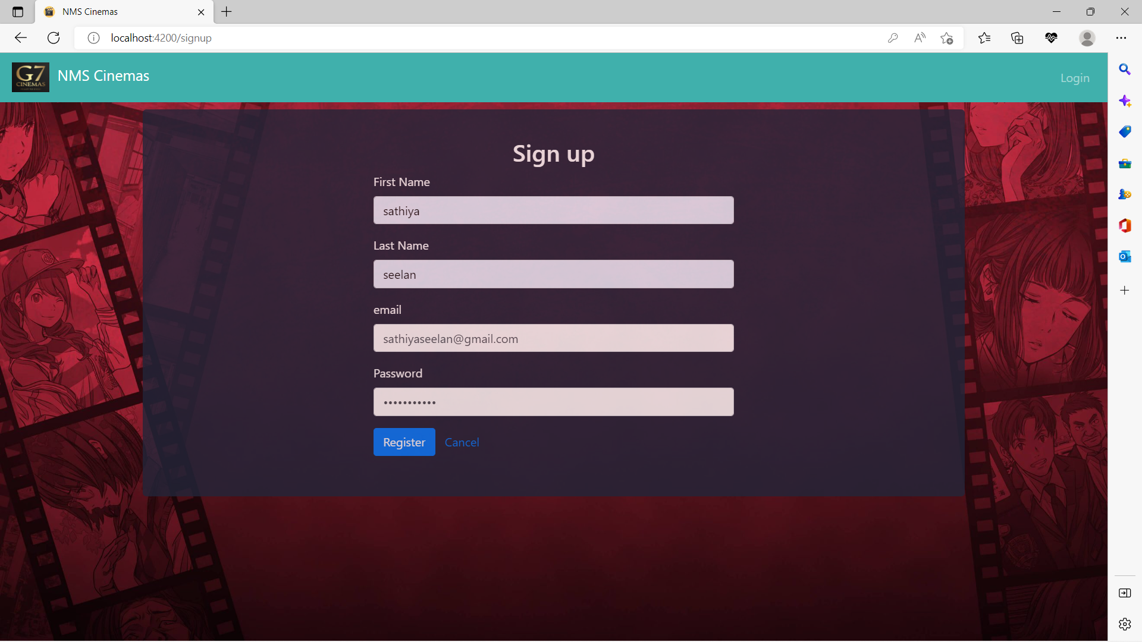
User Register and Login

Slide 33

User Register and Login

Slide 34
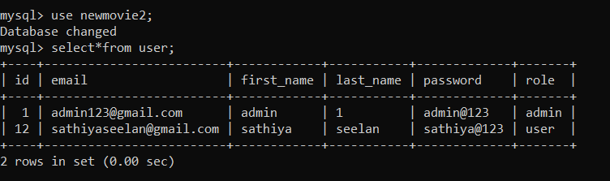
User Register and Login

Slide 35
User Dashboard
User login -> Home , Logout, Movies List added by admin.
User select the movie by clicking the banner.
The home icon -> active shows.
The log out icon -> login page.

Slide 36
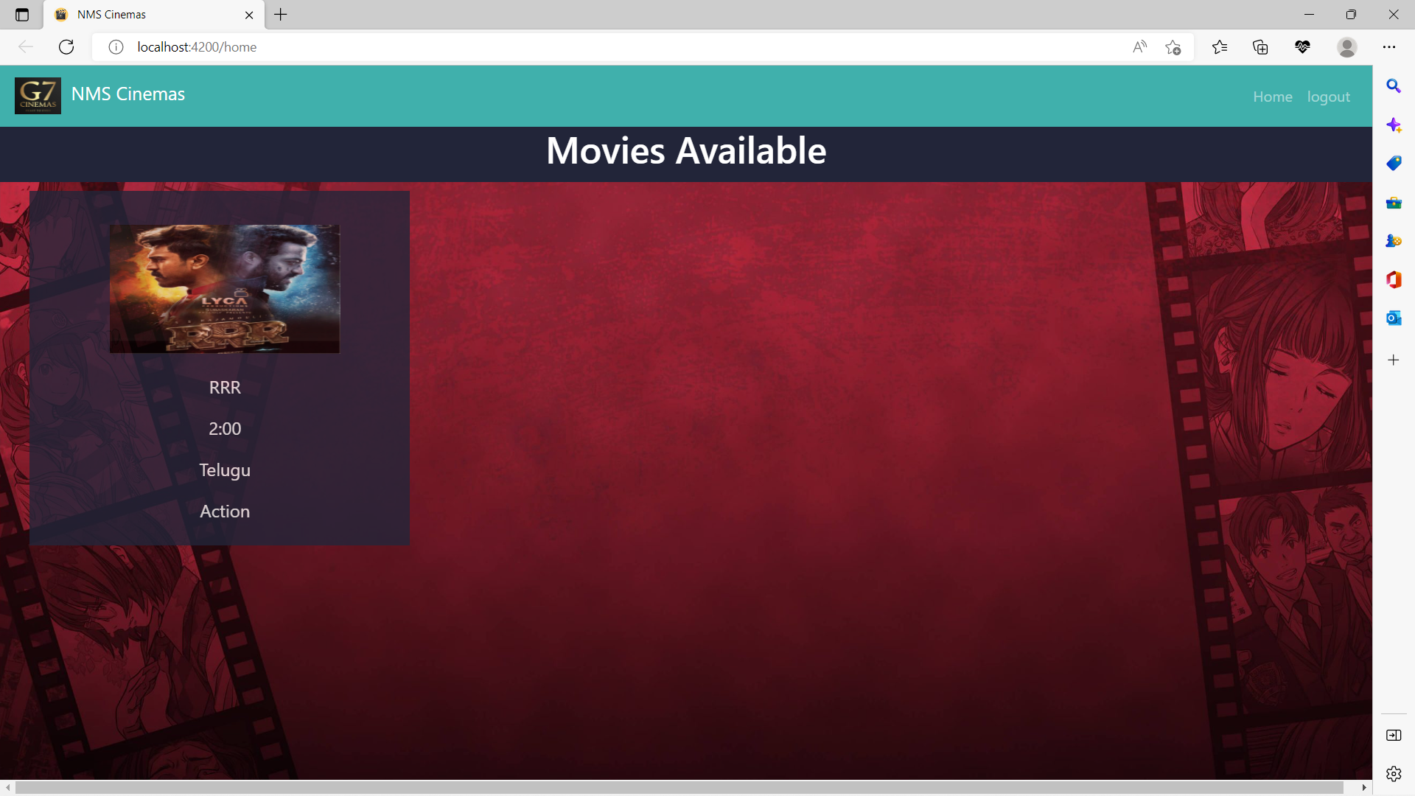
User Dashboard

Slide 37
Movie Booking
Movie booking module -> List of movies is displayed
The user select their wished movie
Select Theater ->Date -> Time.
Redirect to seat selection.

Slide 38
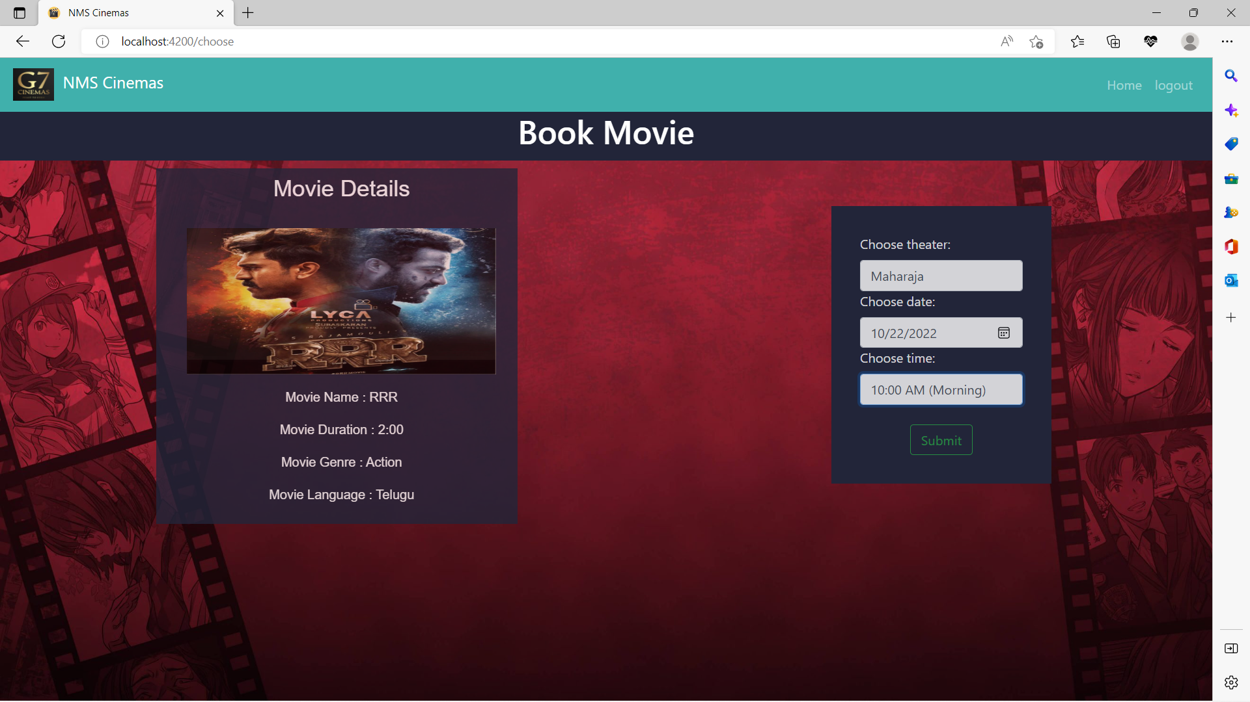
Movie Booking

Slide 39
Seat
Select theater -> Seat selection page.
Seats are displayed as rows and columns
Select the required number of seats
Book seats ->Payment page

Slide 40
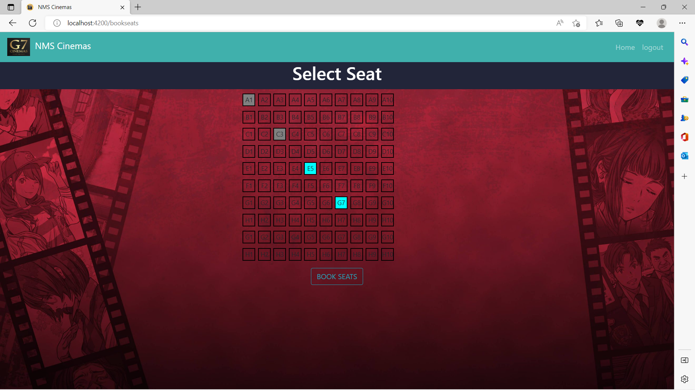
Seat

Slide 41
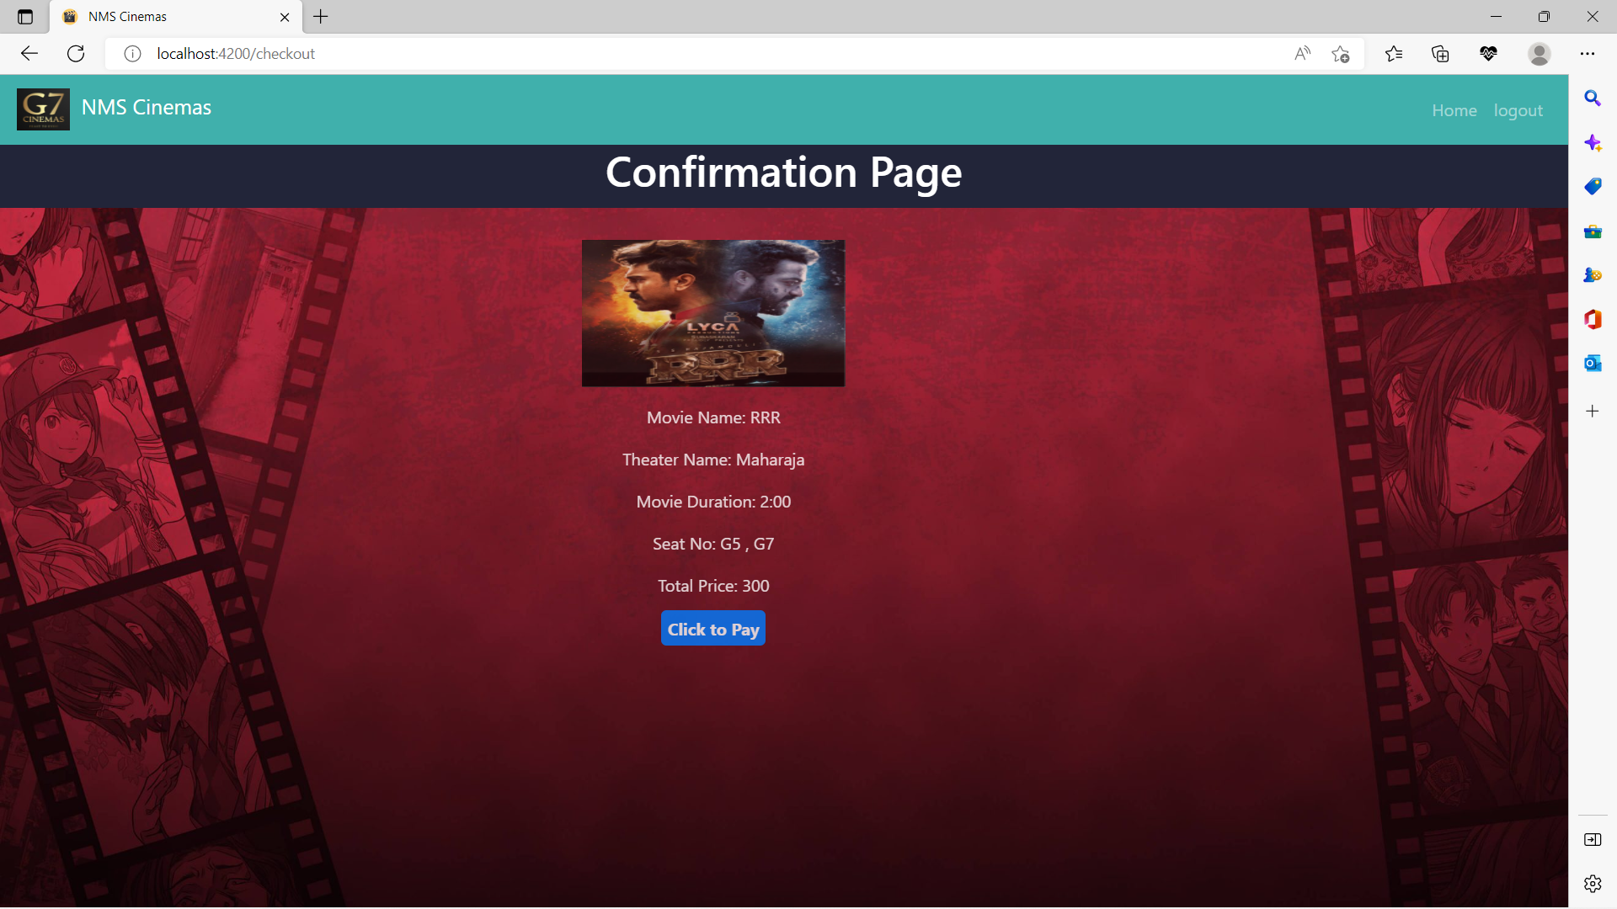
Confirmation Page

Slide 42

Payment
Payment page -> Online mode
Dummy payment gateway.
Payment done -> Confirmation of tickets.
Back to home-> Home page.

Slide 43
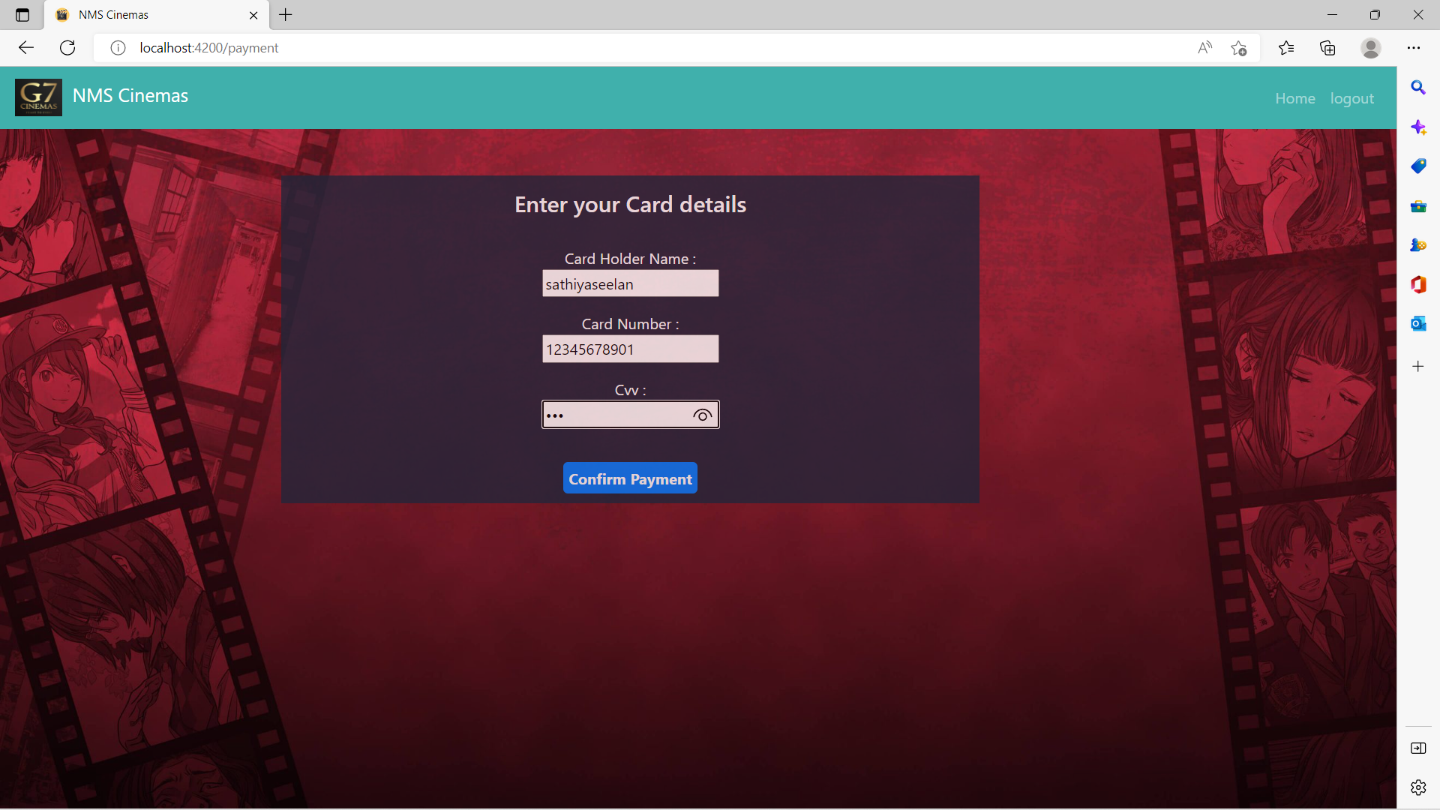
Payment

Slide 44
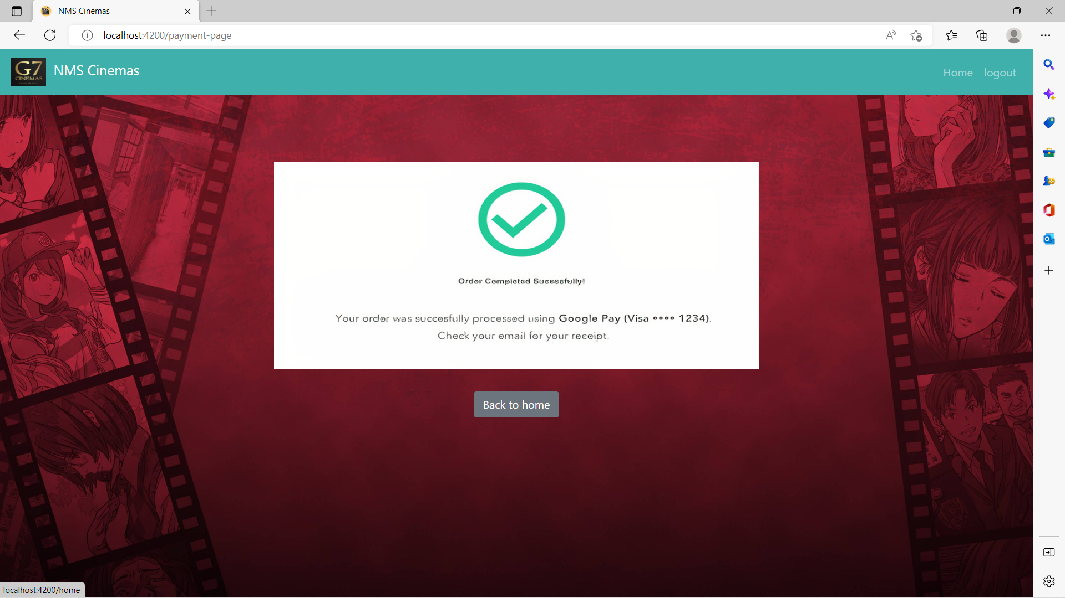
Payment

Slide 45

TESTING

Slide 46
Testing
Selenium
Postman
Selenium automates web browsers. It is most famous for enabling rapid, repeatable web-app testing, which allows developers to ship new releases faster and with confidence.
Postman is an application used for API testing. It is an HTTP client that tests HTTP requests, utilizing a graphical user interface, through which we obtain different types of responses that need to be subsequently validated

Slide 47
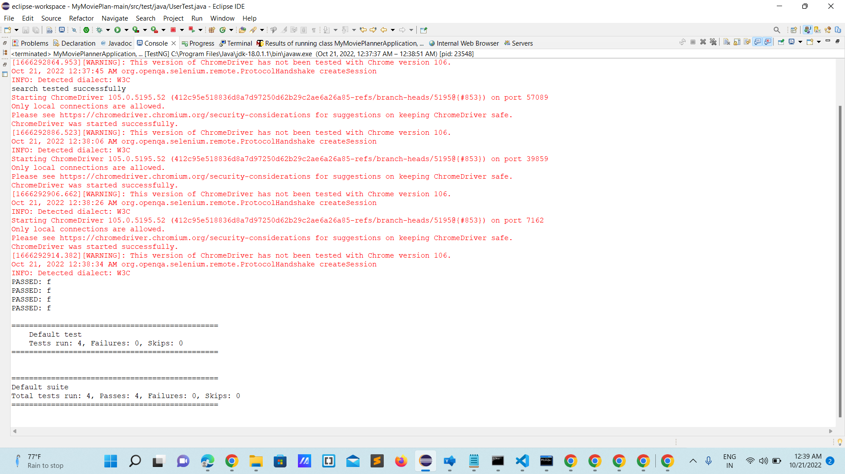
Selenium

Slide 48
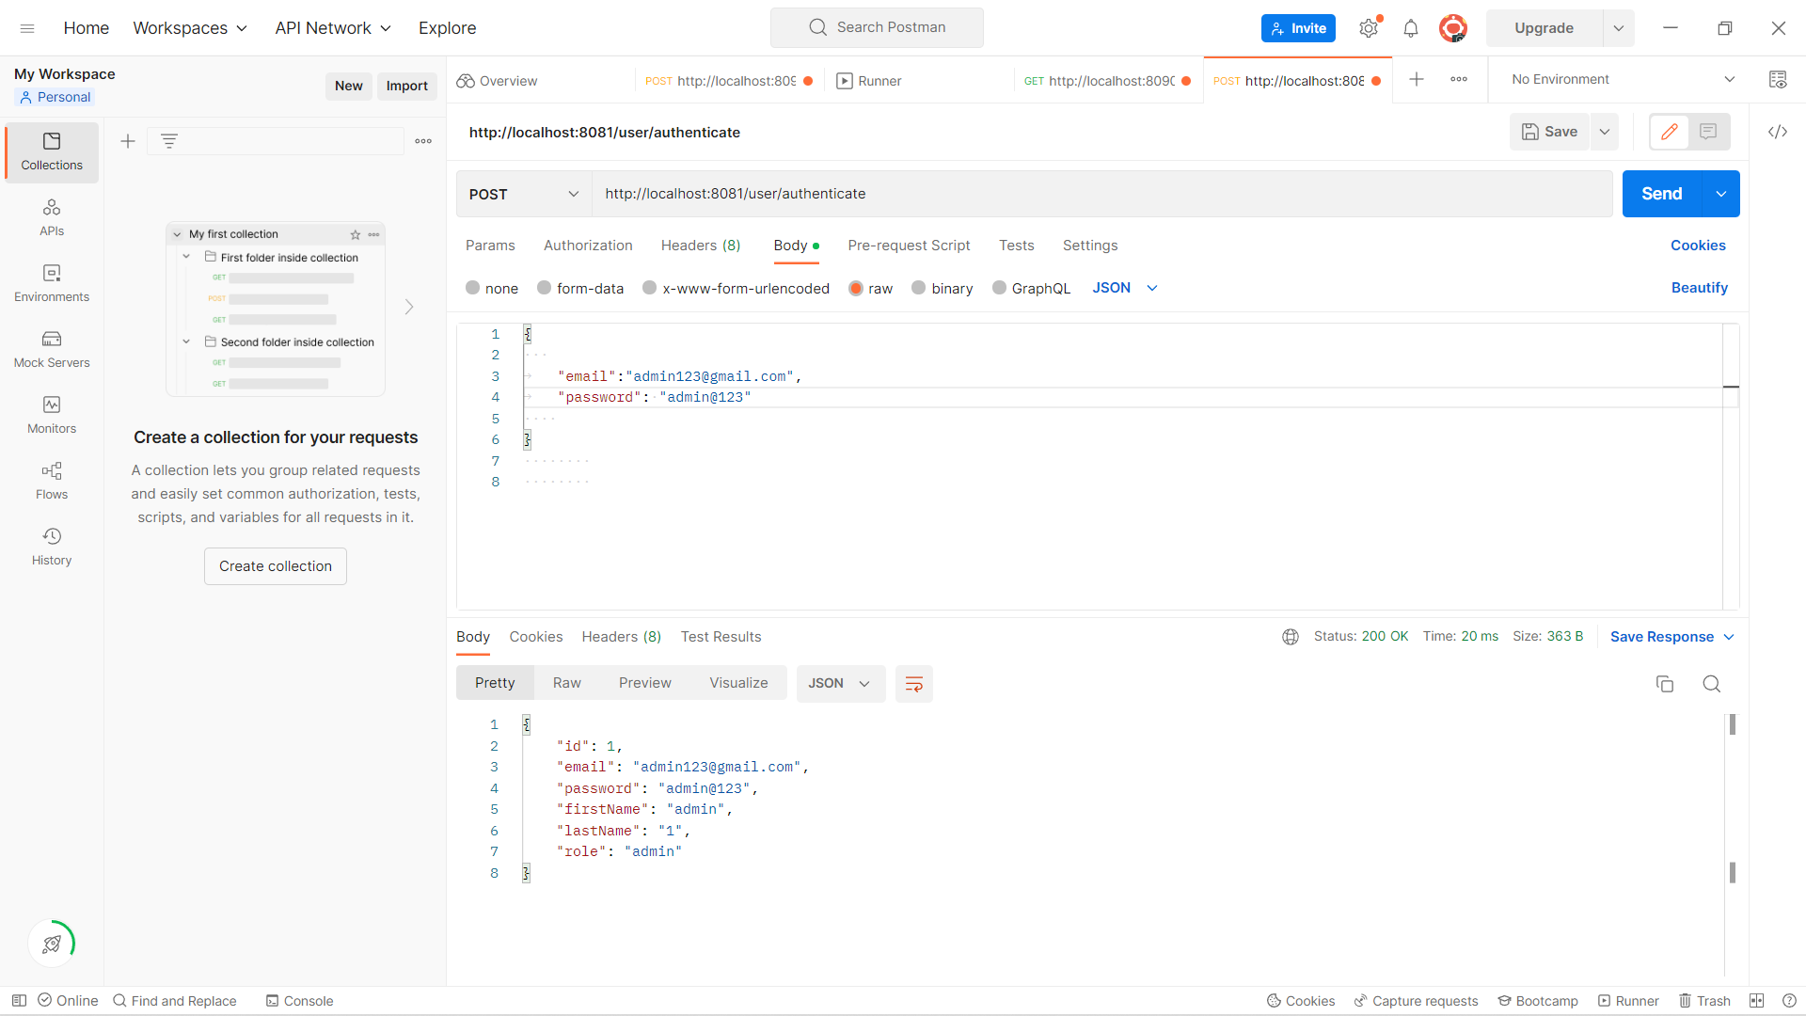
Postman

Slide 49
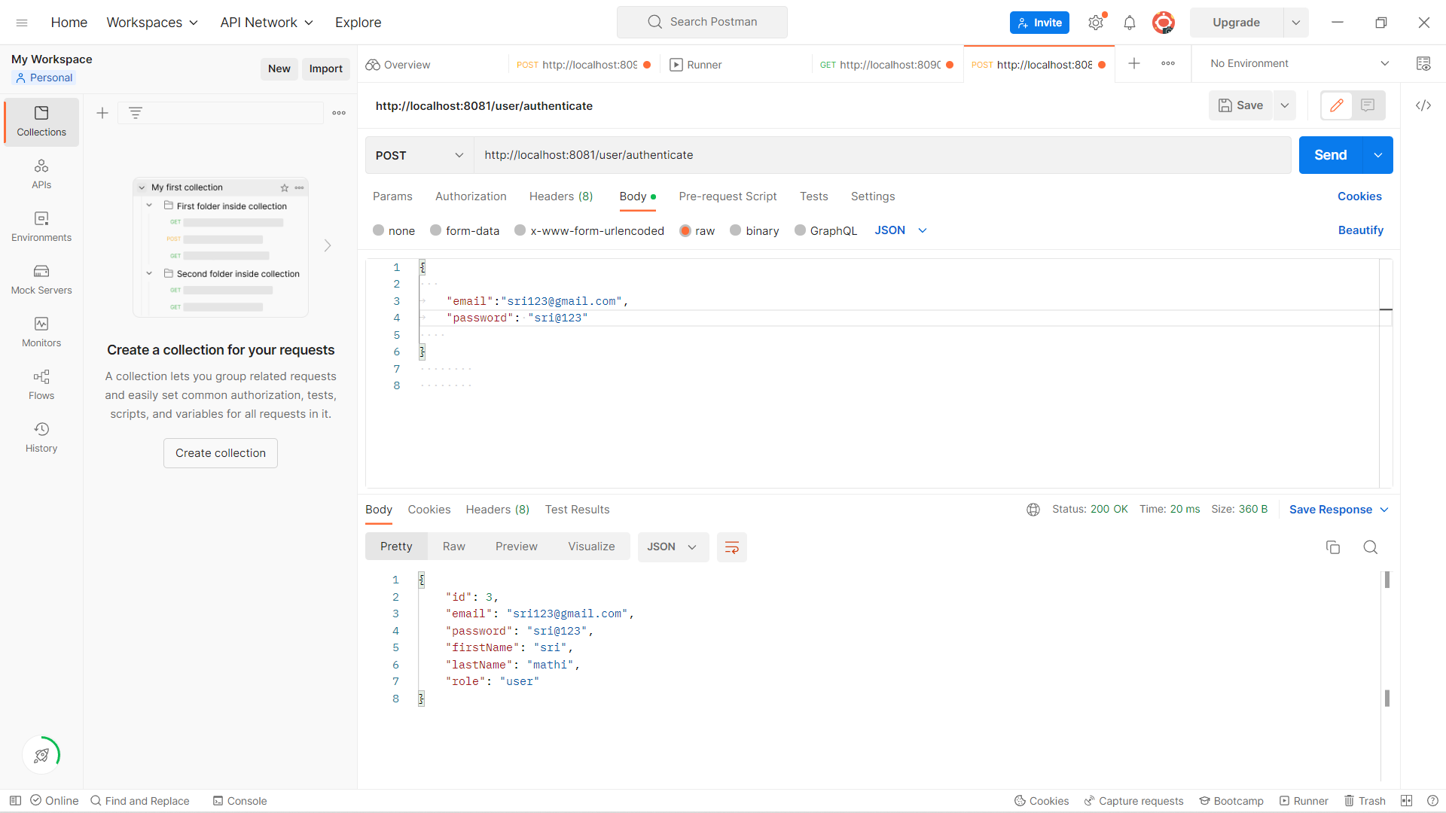
Postman

Slide 50
Conclusion
As said, this project gives real life understanding of online movie ticket booking system and it overcomes the drawbacks in tradional way of booking.
It facilitates speedy booking and saves time for regular people.

Slide 51
THANK YOU

